Slide 1
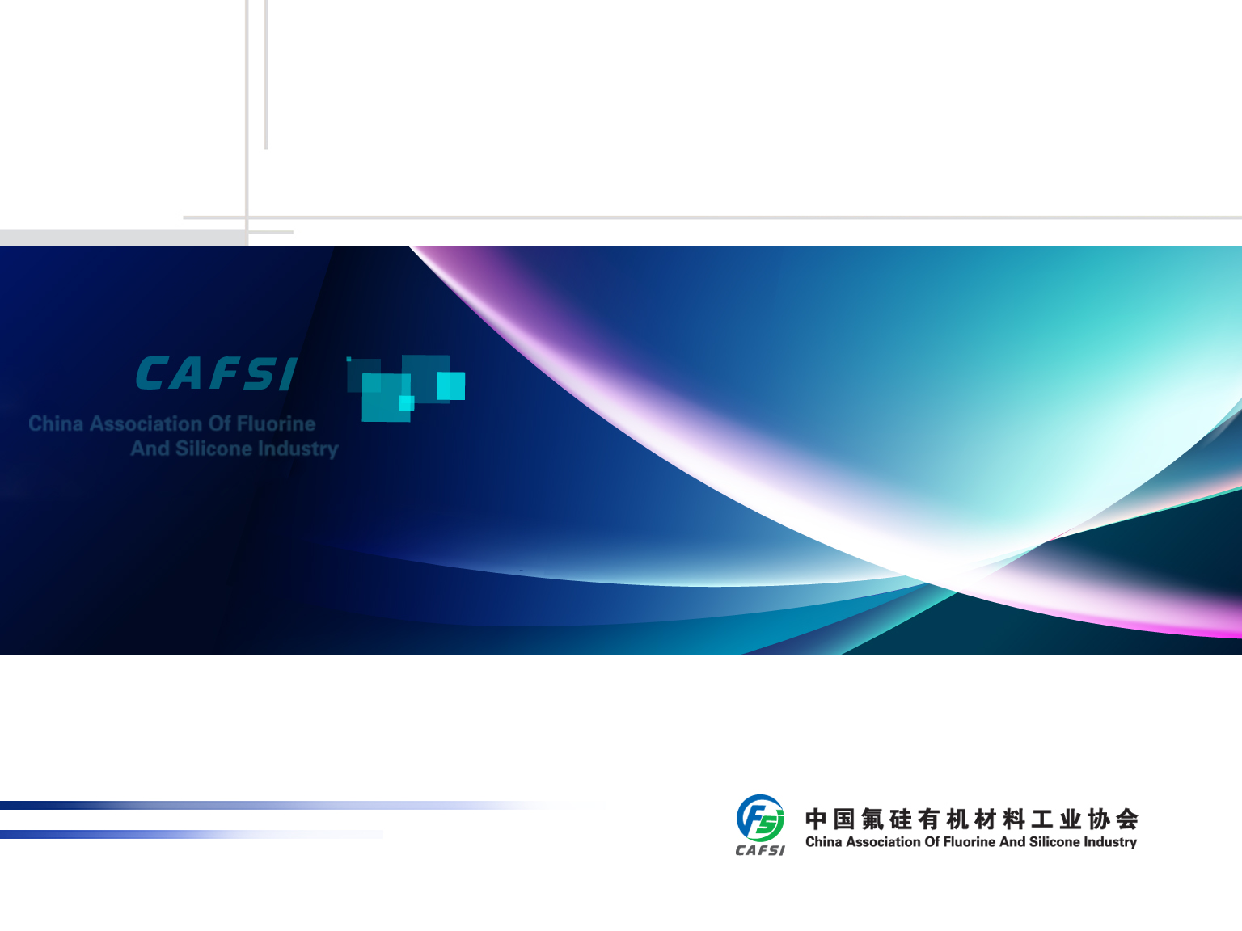
The Impact of Silicone to the Chinese Society and Economy
Xiaoyong Yang

Slide 2
The Impact of Silicone to the Chinese Society and Economy
1
2
3
Outlook of the silicone industry
Overview of the Chinese silicone industry
The impact of silicone on and its importance to national economy

Slide 3

1. Overview of the Chinese silicone industry
Unique Structure
Excellent Performance
Wide Variety
Various Applications

Slide 4
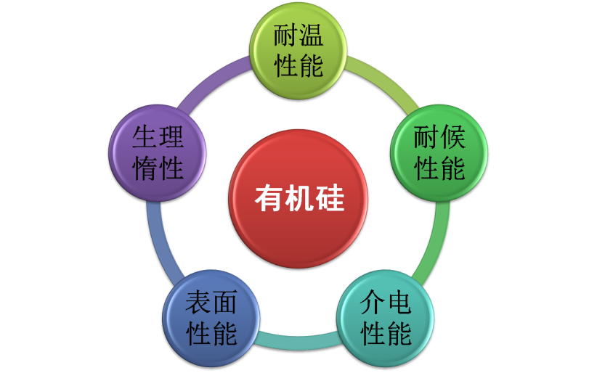
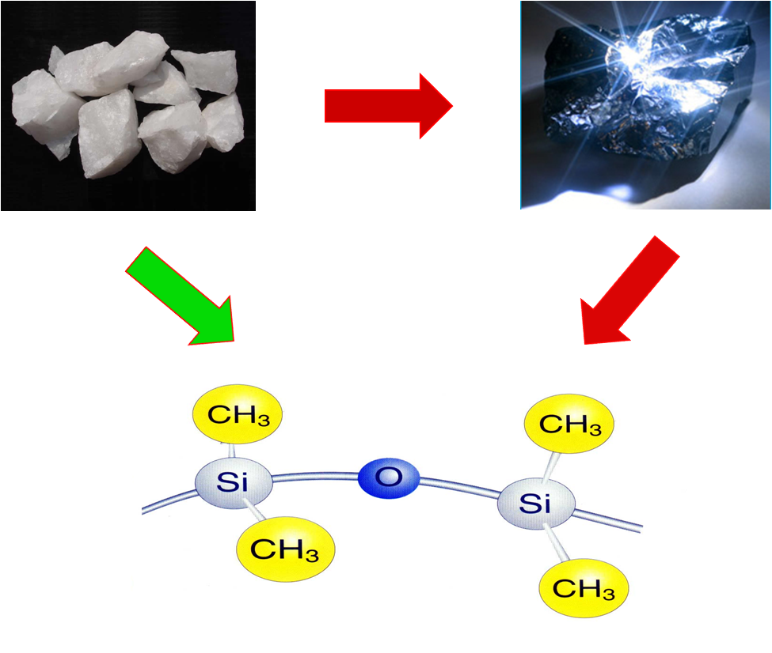
1. Overview of the Chinese silicone industry
Silicone refers to compounds containing carbon–silicon bonds and with at least one organic group connecting directly to silicon atom;
Linear or cyclic polysiloxanes with repetitive Si-O bonds as their backbone chain are called organosilicon polymer.

Slide 5
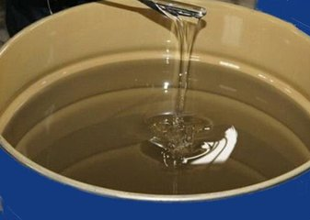
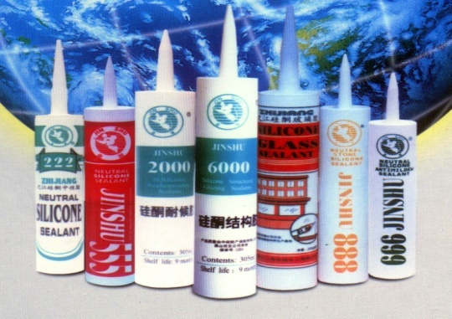
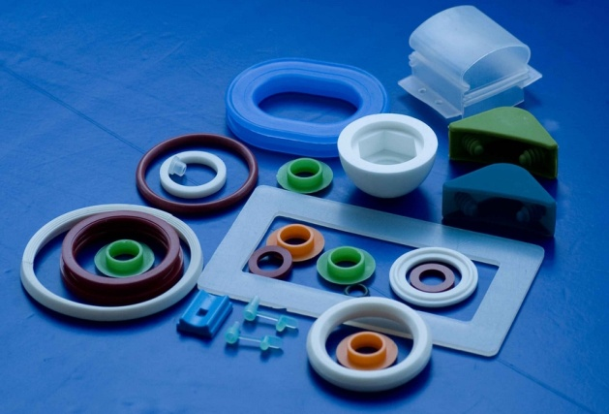
1. Overview of the Chinese silicone industry
The silicone industry has developed a comprehensive value chain with complete product offering. It covers all types of petrochemical products in four major categories, namely silicone oil, silicone rubber, silicon resin and silane with up to 10,000 specifications.
Thanks to its excellent properties, silicone has wide applications and plays an important role in national economy, making it the indispensable high-performance material in modern industry and people’s daily lives.

Slide 6
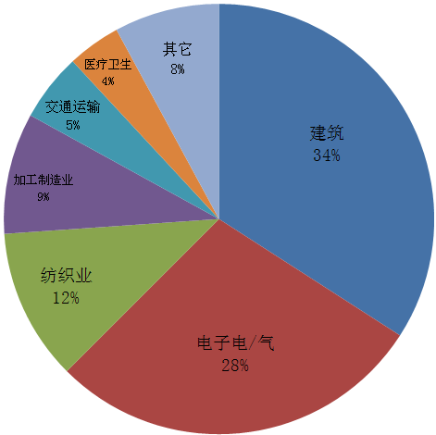
1. Overview of the Chinese silicone industry
Category | share/%
Silicone rubber | 72.3
Silicone oil | 25.6
Silicone resin | 2.1
Consumption and application of silicone in China

Slide 7

1. Overview of the Chinese silicone industry
Production Process of Silicone
Basic raw materials for producing silicone are silicon metal, methanol, hydrogen chloride and other ingredients;
The most important silicone monomer is methyl monomer, which accounts for over 90%, followed by phenyl and vinyl. Methyl monomer is the supporting pillar of the whole industry;
Silicone intermediates are various linear and cyclic polysiloxanes as well as base silicone oil and rubber;
The monomers and intermediates are further processed into final products such as silicone oil, rubber, resin and silane coupling agent through various reactions and addition of fillers and neccessary ingredients.

Slide 8
1. Overview of the Chinese silicone industry
Development of the silicone industry in China
Beginning: 1950s ～ 1970s
Growing: 1980s ～ 1990s
Fast development: since 2000

Slide 9

1. Overview of the Chinese silicone industry
3.0%
2.8%
9.5%
Global siloxane production and consumption in 2000

Slide 10
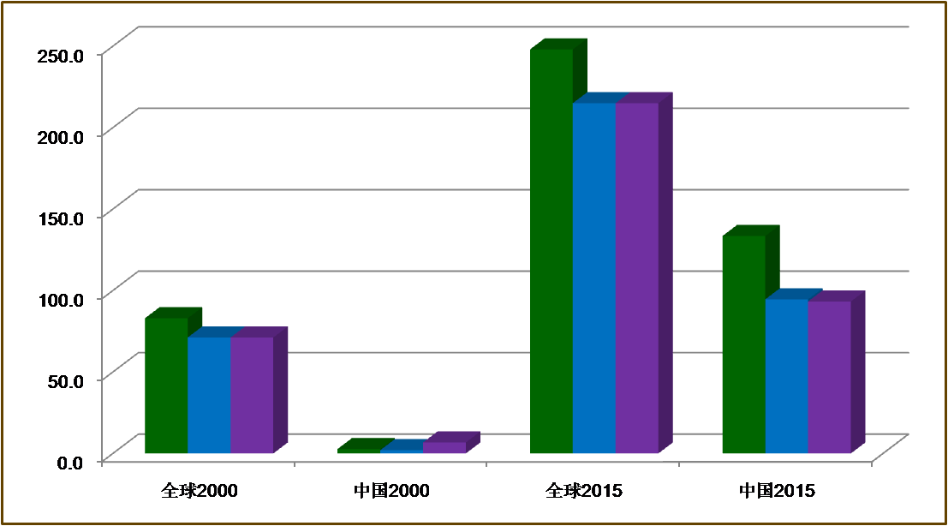

1. Overview of the Chinese silicone industry
The global capacity, production and consumption of silicone doubled during the period of 2000-2015. During the same period, capability, production and use in China grew by 48, 46 and 13 times respectively.
China accounted for 55% of world’s silicone production capacity and 45% for output and consumption in 2016.
The global market is estimated at 25bil USD and the figure for China is 60bil RMB.

Slide 11
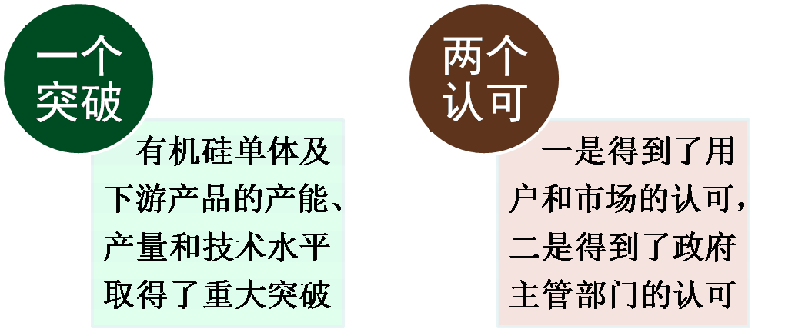
1. Overview of the Chinese silicone industry
After decades of development, China now enjoys a comprehensive silicone industrial system featuring production of raw materials, intermediates and end products, education, scientific research, engineering development and design as well as supporting industries in the areas of processing agent, equipment manufacturing, analysis and testing, automation, logistics and warehousing and environmental protection.

Slide 12
The Impact of Silicone to the Chinese Society and Economy
1
2
3
Outlook of the silicone industry
Overview of the Chinese silicone industry
The impact of silicone on and its importance to national economy

Slide 13
2. The impact of silicone on and its importance to national economy
❶ Drive China’s industrial development and economic growth
As an important example of new materials, silicone is becoming increasingly relevant to people’s daily life, industrial & agricultural production and development of high and new technologies as the demand for high-performance materials grows due to socio-economic development.
Silicone products are widely used in almost all industries and high-tech spaces such as aerospace, electronic information, construction, textile, automobile, new energy, energy conservation/environmental protection, agriculture, food processing, healthcare, household chemicals and personal care.
The rapid development of the silicone industry and wide adoption of its products have spurred many technological revolutions and industrial upgrades, making it an important contributor to the reform and upgrade of existing industries, nurturing of new industries as well as promoting economic growth.
“Substitute” and “performance enhancement” are the two main features of silicone application.

Slide 14

2. The impact of silicone on and its importance to national economy
Global manufacturing activities began its moving into China post 1980s. Industries such as fabric and garment, household appliance, automobile and construction flourished. The development of which was greatly aided by the use of silicone.
Silicone finishing agent
Fabric and garment
RTV silicone rubber
TV and other appliances
HTV silicone rubber
Car, computer, phone etc.
Silicone sealant
Building and interior

Slide 15
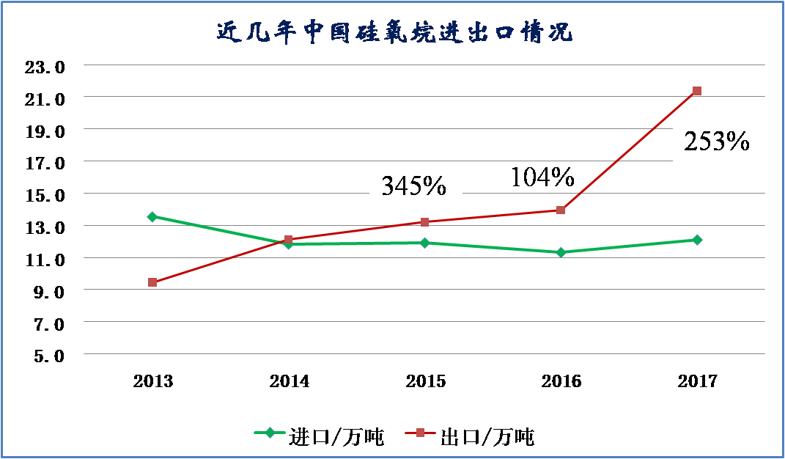
2. The impact of silicone on and its importance to national economy
❷ Domestic innovation to boost local industry’s competitiveness
Chinese silicone industry begins to develop proprietary processes and techniques through academic-industry cooperation and innovation and demonstrates economy of scale. The industry is becoming increasing competitive as local products begin to replace imported ones.
It has become a high-tech industry with promising future as it enjoys a large number of manufacturers, complete range of products and close relationships with other industries.

Slide 16
2. The impact of silicone on and its importance to national economy
❸ Job creation to stimulate economic growth
The long value chain of silicone industry comprises of raw materials, monomers, intermediates, end-products as well as processing agents, equipment and application technology, covering wide spectrum of professions and demanding huge manpower.
The number of silicone professionals in China is around 150,000 while the figure for supporting and related industries is over 1million. As silicone materials and technologies are great drivers of product and technology upgrades in other industries, the multiplier effect ripples across every corner of the national economy, creating uncountable number of indirect jobs.
The development of silicone industry has generated many employment opportunities both within and outside the industry, contributing greatly to the effort of reducing employment pressure, stimulating economic growth and stable social development.

Slide 17
2. The impact of silicone on and its importance to national economy
❹ Technology-driven industry development makes
China voice carry more weights
Almost all chemical material research institutes and higher education institutions which offer such subjects have dedicated teams conducting silicone-related studies. Nationally-important industries such as aerospace, nuclear, automobile and electronic information also have special agencies committed to silicone material R&D.
China has developed a relatively comprehensive system capable of providing fundamental research, process development, engineering design, training and development, QC services to safeguard the industry’s development.
China Bluestar Chengrand: national silicone engineering technology research center
CAS Institute of Chemistry: engineering center of advanced polymer for national defense innovation of CAS
Shandong University: key lab of special functional aggregated materials under ministry of education (MOE)
Wuhan University: silicone compound and material engineering research center under MOE
Hangzhou Normal University: key lab of silicone chemistry and material technology under MOE

Slide 18
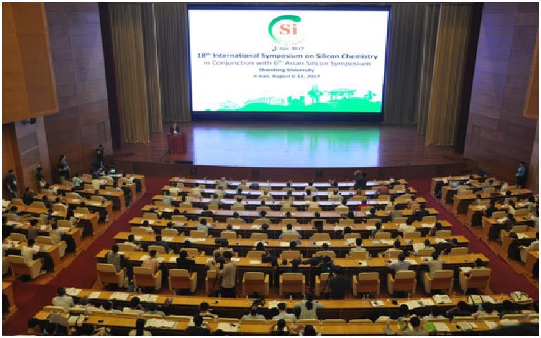

2. The impact of silicone on and its importance to national economy
China successfully hosted ISOS XVIII and ASiS-VI in August 2017.
The conference attracted professionals and academics from over 20 countries including Germany, the US, Japan, Canada, France and Russia. It boasted the highest turnout in history with 736 registered attendees, of which 259 are international guests.

Slide 19
2. The impact of silicone on and its importance to national economy
❺ The rise of emerging industries guided by
silicone technology
Not only is silicone an important part of strategic emerging industries and new materials, it is also an indispensable supporting material for other strategic emerging industries. In the "High-tech Products Catalogue of China" and "Catalogue of Strategic Emerging Industries" issued by various ministries and commissions of the State Council throughout the year, silicone materials have always been listed as a new chemical material to be further developed.
In addition to effectively promoting technological upgrading and industrial development in traditional industries such as construction, textiles, and electrical and electronic industries, silicone strongly supports and safeguards the integrated innovation effort and sound development of national strategic emerging industries and other key industries such as energy conservation and environmental protection, next generation information technology, new energy, defense and military and high-end equipment manufacturing.
It is estimated that the use of silicone materials accounts for 30% of the total material consumption in strategic emerging industries.

Slide 20
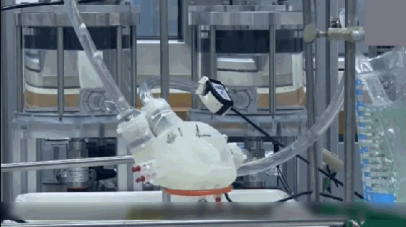
2. The impact of silicone on and its importance to national economy
❻ Improve people’s quality of life and standard of living
“…We strive to fulfill people's desire for a good and beautiful life …”
Silicone is widely used in healthcare sector and many aspects of daily life because it is safe, toxic-free, stable and biocompatible, making it an excellent representation of President Xi’s aspiration.
  Medical devices
  Sports equipment
  Kitchenware
  Infant product
  Cosmetic skin care
  Personal care

Slide 21
2. The impact of silicone on and its importance to national economy
❼ Replace petroleum-based products
to mitigate oil crisis
China imported 67.1% of petroleum in 2017.
Silicone is less dependent on oil and natural gas and is an ideal substitute for petroleum-based synthetic materials. Accelerating the replacement of these materials with silicone is of great strategic importance.
Proved reserves: 3.5bil tons
Reserves: 1.5%
Production: 4.3%
Consumption: 12.8%
fuel ☛ new energy and new energy car
Chemical material ☛ silicone

Slide 22
2. The impact of silicone on and its importance to national economy
❽ Enable circular economy and clean production with innovation
China is a global leader in glyphosate production, resulting in approximately 700,000 tons of methyl chloride being generated as by-product every year.
Prior to its use in the production of silicone monomers, glyphosate’s by-product methyl chloride was mainly disposed of as waste. It is now fully recycled and about 90% of which is used for silicone production, accounting for around 35% of all methyl chloride used for synthesizing silicone monomer.
The use of methyl chloride, a by-product of glyphosate, as raw material for the production of organosilicon monomers not only solves the problem of methyl chloride contamination, but also achieves efficient recycling of resources and maximization of its use. It is a classic clean production and circular economy model which sets a good example in building a resource-saving, environment-friendly society and realizing its sustainable development.

Slide 23
2. The impact of silicone on and its importance to national economy
Comprehensive use and circular economic model with Si-P-Cl

Slide 24
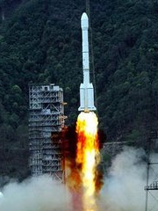
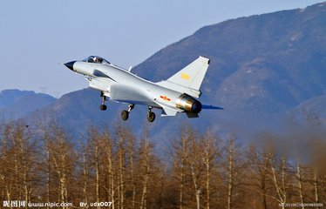


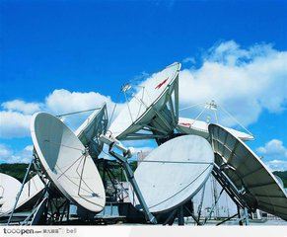
2. The impact of silicone on and its importance to national economy
❾ Explore military application to support
national defense
The various types of domestically developed silicone materials have become an indispensable and irreplaceable component of national defense modernization and national major projects, ensuring the smooth execution of almost all major national projects such as “Two Bombs, One Satellite” and manned space.
Although the quantity of silicone used in the defense industry is small, it is nothing short of important due to its wide variety and high performance.

Slide 25
The Impact of Silicone to the Chinese Society and Economy
1
2
3
Outlook of the silicone industry
Overview of the Chinese silicone industry
The impact of silicone on and its importance to national economy

Slide 26
3. Outlook of the silicone industry
13th Five-Year Development Goal
Silicone consumption in China has been strong since 1990s with average annual growth rate far greater than world average and its economic growth.
Annual growth rate of siloxane consumption in the 13th five year period is expected to be 9%.
22%

Slide 27
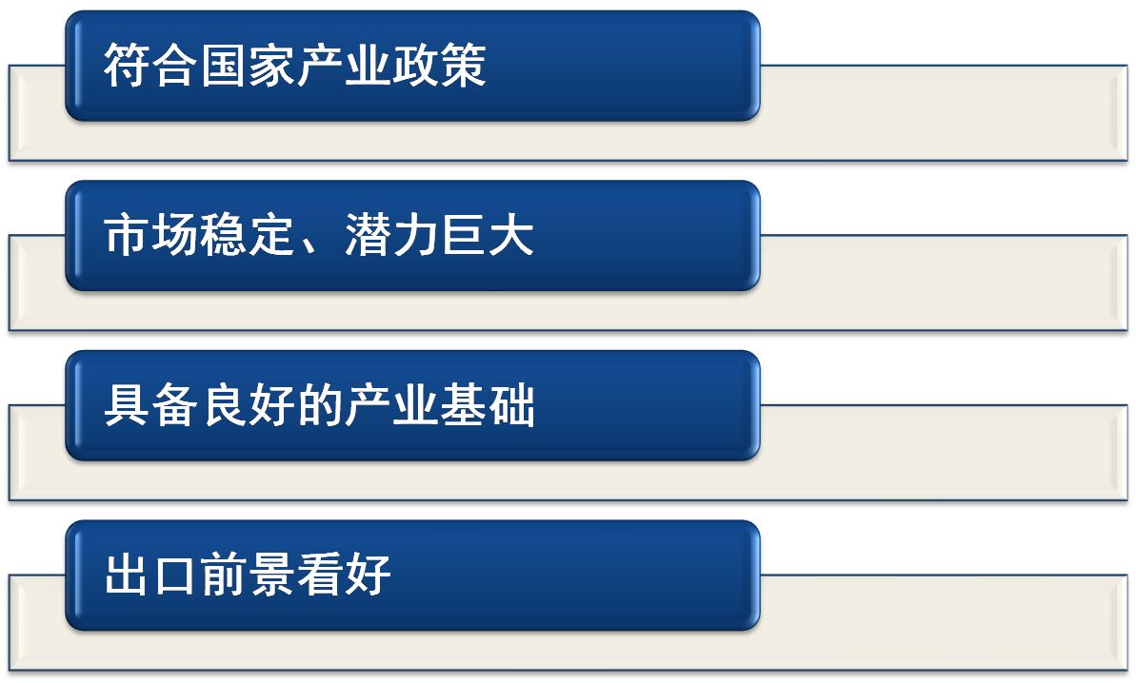
3. Outlook of the silicone industry
Advantages

Slide 28
3. Outlook of the silicone industry
Key Areas to Develop
Construction, textile and household appliance
Construction, textile and household appliance have always been the receiving ends of silicone, accounting for half of the siloxane usage. Although these industries have already grown passed the period of rapid development, they will remain the main application areas of silicone materials for a long time to come and still maintain a good growth rate.
Electric & electronics, automobile, processing and manufacturing
With electronic components get smaller and more integrated and as more high-voltage, EHV and UHV power transmission lines being built, the demand for high-performance silicone in these areas will increase significantly.
China's high-speed railway and rail transit, aviation, shipbuilding, and marine equipment sectors have entered a period of rapid development and will drive the development and application of high-performance silicone materials.

Slide 29
3. Outlook of the silicone industry
Healthcare and household chemicals
Silicone is widely used in medical and household chemical industry for its excellent physical, chemical and physiological properties:
  Medical instruments, human organs, artificial skin
  Hygiene products, family planning products, bionic products
  Personal accessories, home supplies, kitchen supplies, baby supplies
  Beauty, makeup and personal care products
  In the future, the application of silicones in these fields will grow at a relatively rapid pace, which will lead to the development of medical and sanitary-grade silicone products.

Slide 30
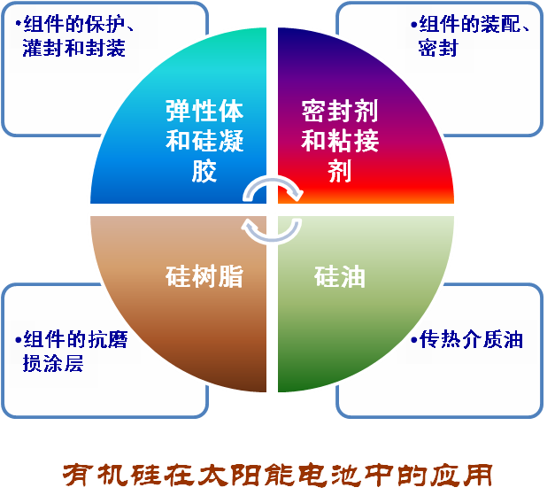
3. Outlook of the silicone industry
PV and LED
As an inexhaustible source of clean energy, Solar energy is the only energy that meets the demand of humanity in the future. Since 2010, Chinese photovoltaic industry has developed rapidly. In 2017, the installed capacity of photovoltaic power generation in China reached 130GW.
In 2017, the total output of photovoltaic components in China was about 83GW, an increase of 44.4% year-on-year. It is expected to exceed 120 GW in 2018.

Slide 31

3. Outlook of the silicone industry
With properties of high brightness, low power consumption, long life-cycle, and wide application, LED has become the most promising new source of light.
According to the national "13th Five-Year Development Plan for Semiconductor Lighting Industry," China's sales of LED lighting products will account for 70% of the total sales of the lighting industry in 2020, which will save 340 billion kWh of electricity and reduce 306 million tons of CO2 emissions.
Main applications of silicone in the field of LED
LED packaging | Packaging glue
 | Adhesives (solid crystal, glue)
Power | Bonding, potting, heat dissipation
Screen | potting
Lighting | Bonding, sealing, heat dissipation

Slide 32

3. Outlook of the silicone industry
❺ New energy vehicles
In 2017, the production and sales of new energy vehicles in China reached 794,000 and 777,000 units, an increase of 53.8% and 53.3% year-on-year, and the car ownership exceeded 1.8 million, accounting for over 50% of the global market.
According to the “Energy Conservation and New Energy Vehicle Industry Development Plan (2012-2020)” by the State Council, the production and sales volume of China's new energy vehicles will reach 2 million by 2020, and the cumulative production and sales volume will reach 5 million, meaning a more than 50% average annual growth rate during the 13th Five-Year Plan period.
Silicone encapsulates the entire battery pack (component) for stabilization, vibration protection, heat dissipation, water and dust proofing effect. It is also used for bonding and positioning of power battery cells and thermal management of lithium batteries.

Slide 33
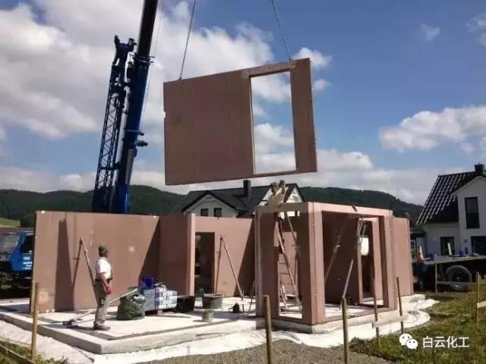
3. Outlook of the silicone industry
❻ Prefabricated buildings
The "Opinions of the General Office of the State Council on Accelerating the Sustainable Development of the Construction Industry" suggests the need to develop prefabricated concrete structures, steel structures and modern wood structures and other fabricated structures where appropriate. China will strive to make prefabricated buildings accounting 30% of the total area of newly constructed buildings.
More adhesives will be used in prefabricated construction and higher requirements are placed on the adhesive properties of sealants and concrete, as well as the properties of weathering resistance, stain resistance, and brushability.
China is a late comer in the study of MS glue and its consumption is far lower than that in the United States, Europe, and Japan.

Slide 34
3. Outlook of the silicone industry
❼ 3D printing materials and wearable devices
◆ 3D printing is a new technology for constructing objects by adding materials layer by layer. Countries around the world are continuously strengthening the research, development, and application of 3D printing technologies.
◆ Photo-curing and heat-curing silicone rubber and silicone resins, addition-type silicone rubber, and thermoplastic silicone elastomers are expected to find application in 3D printing.
◆ Smart wearable devices such as wristwatches, wristbands, glasses, helmets which have direct contact with human body have flourished in the past two years, making them the next hotspot in the smart device industry.
◆ Almost all wearable devices are in direct contact with human skin. Silicone rubber or modified silicone rubber has moderate hardness and good compatibility with human body. It is most suitable for skin contact products.

Slide 35
3. Outlook of the silicone industry
❽ The “National Business Card” strategy
High-speed railway
The high-speed railway demonstrates the high quality China's equipment manufacturing industry. It is also a ‘popular item’ in the Going Global and the Belt and Road initiatives, making it a wonderful business card. (Xi Jinping)
Nuclear Power
“Hualong One” have made me proud，I’ll make it shine on the world stage.
(Li Keqiang)
UHV
Silicone rubber composite insulators prevent pollution flashover, and are easy to operate and maintain. They have become the most widely used insulators, accounting for over 50% of insulator usage for 6 consecutive years from 2012 to 2017.

Slide 36
Thank You!

